Slide 1
Normalization

Slide 2
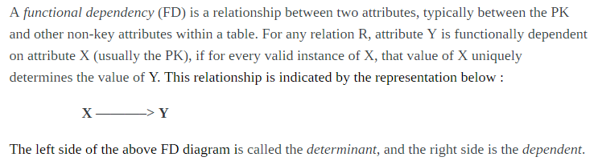
Functional Dependencies

Slide 3
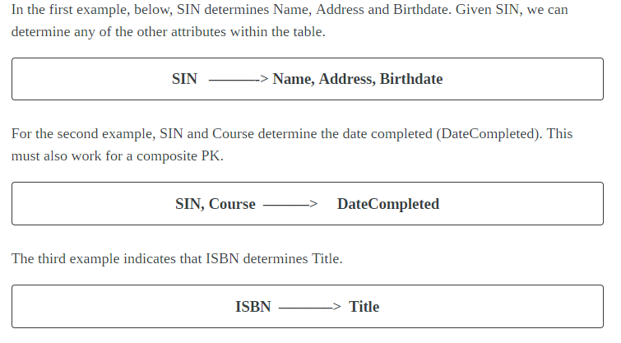

Slide 4
Data base anomalies
Anomalies are problems that can occur in poorly planned, un-normalised databases where all the data is stored in one table (a flat-file database).
Types:
1. Update
2. Insert
3 Delete anomalies

Slide 5
Types
Insertion Anomaly - The nature of a database may be such that it is not possible to add a required piece of data unless another piece of unavailable data is also added. E.g. A library database that cannot store the details of a new member until that member has taken out a book.
Deletion Anomaly - A record of data can legitimately be deleted from a database, and the deletion can result in the deletion of the only instance of other, required data, E.g. Deleting a book loan from a library member can remove all details of the particular book from the database such as the author, book title etc.

Slide 6
Modification Anomaly - Incorrect data may have to be changed, which could involve many records having to be changed, leading to the possibility of some changes being made incorrectly.

Slide 7
Empno | Projno | Ename | Pname | No_hours
E1 | P11 | A | Adv | 11
E2 | P10 | B | Billing | 12
E6 | P10 | C | Billing | 15
E3 | P12 | D | Seals | 20
E5 | P10 | E | Billing | 10
1.Update P10—Billing to accounting
2. We can not insert new project without assigning employees
3.Deletion P12 – losing detail of employee D

Slide 8
Functional dependency
Full functional dependency
Partial functional dependency
Transitive functional dependency
Multi-valued functional dependency
Join functional dependency

Slide 9
Functional dependency
A B
A-determinant
B-determined
Part_name | Cost
Hard disk | 1500
Pen drive | 700
Hard disk | 1500
CD | 10
Pen drive | 700

Slide 10
Full functional dependency
An attribute is FFD on a set of attributes if
It is functionally dependent on S and
Not functionally dependent on any proper subset of S.

Slide 11
Roll_num | NAme | Course_id | course_title | Grade
1 | Raj | CSE301 | DBMS | A
1 | Raj | CSE306 | NW | C
2 | Ankur | CSE301 | DBMS | B
2 | Ankur | CSE306 | NW | A
3 | Arun | CSE316 | SOFT ENGG | C
roll_num ,course_id Grade
Name and course_title are not fully functional dependent on composite key

Slide 12
Partial dependency
The value of one attribute is dependent on another attribute of relation which is a part of composite key.
Name is partially dependent on roll number.

Slide 13
Transitive functional dependency
Dept_id | Dept_name | Hod_name
1 | CSE | Mr X
2 | IT | Mr Y
3 | ECE | Mr Z
4 | ME | Mr A
Dept_id Dept_name Hod_name
A B C

Slide 14
Multi-valued functional dependency
Name | Ph_number
Ram | 987217701
Sham | 982271661
Ram | 876622134
Rajesh | 872213477
Raj | 657932721
Ajay | 873539262
A B
Name Ph_number

Slide 15
Decomposition of tables
Lossy decomposition
Lossless decomposition

Slide 16
Consider following table
Model | Price | Make
N12 | 10000 | CANON
P20 | 12000 | NIKON
A73 | 15000 | CANON
This can be further divided as following
Model | Make
N12 | CANON
P20 | NIKON
A73 | CANON
price | make
10000 | CANON
12000 | NIKON
15000 | CANON

Slide 17
Now try to re-create original table
model | price | make
N12 | 10000 | CANON
N12 | 15000 | CANON
P20 | 12000 | NIKON
A73 | 10000 | CANON
A73 | 15000 | CANON

Slide 18
Properties of Decomposition
Following are the properties of Decomposition, 1. Lossless Decomposition 2. Dependency Preservation 3. Lack of Data Redundancy

Slide 19
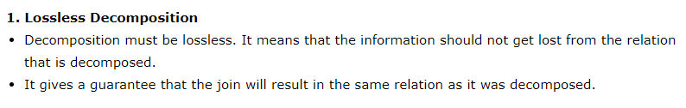
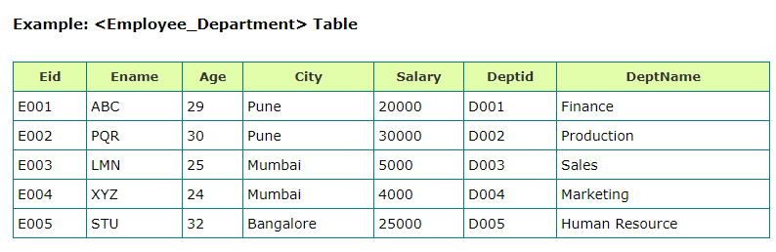

Slide 20
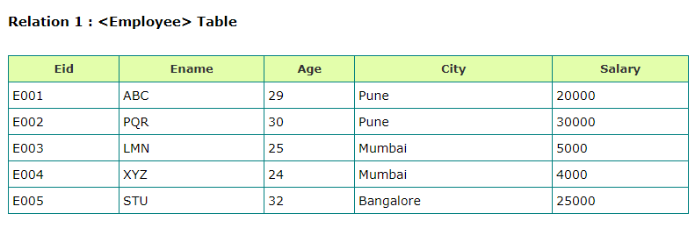
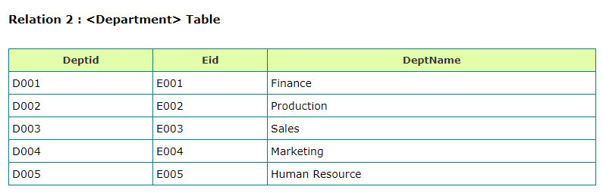

Slide 21
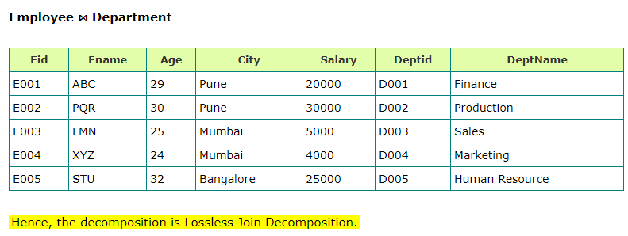

Slide 22
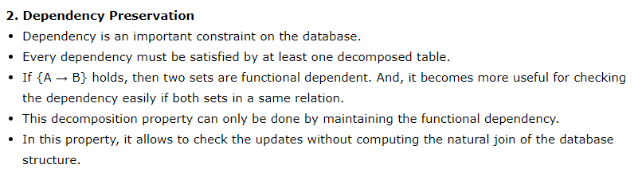
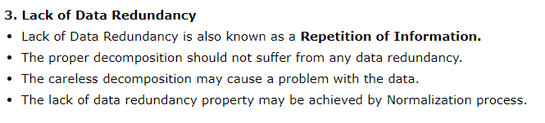

Slide 23
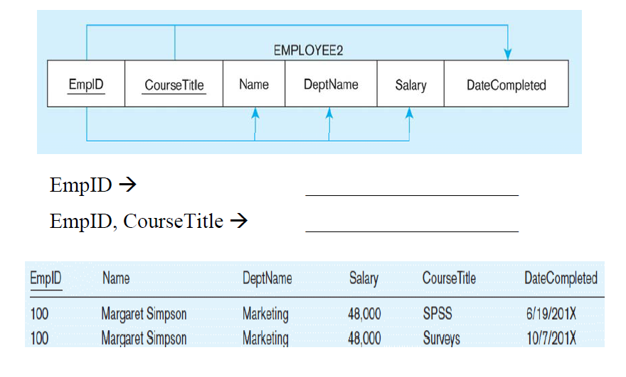
Functional dependency diagram

Slide 24
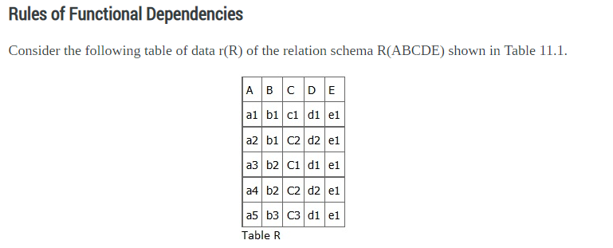
What kind of dependencies can we observe among the attributes in Table R? Since the values of A are unique (a1, a2, a3, etc.)??????

Slide 25
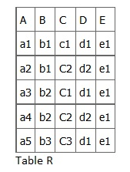
it follows from the FD definition that:
A → B, A → C, A → D, A → E
It also follows that A →BC (or any other subset of ABCDE).
This can be summarized as A →BCDE.
From our understanding of primary keys, A is a primary key.
Since the values of E are always the same (all e1), it follows that:
A → E, B → E, C → E, D → E
However, we cannot generally summarize the above with ABCD → E because, in general, A → E, B → E, AB → E.

Slide 26
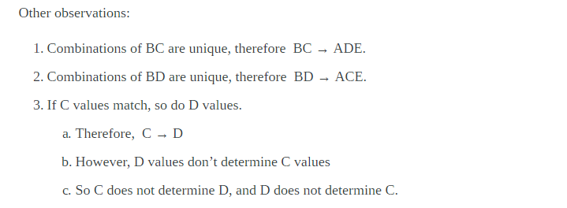

Slide 27

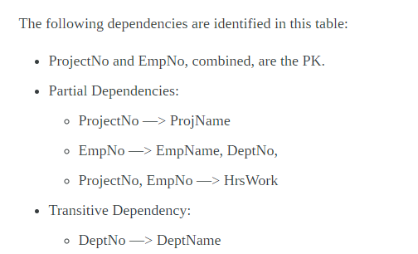
Dependency Diagram
A dependency diagram, shown in Figure 11.6, illustrates the various dependencies that might exist in a non-normalized table. A non-normalized table is one that has data redundancy in it.

Slide 28
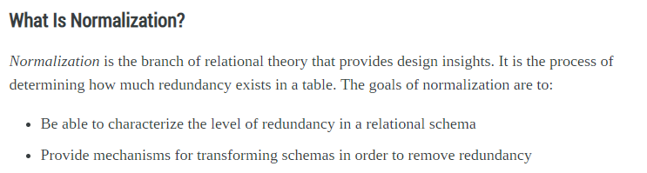
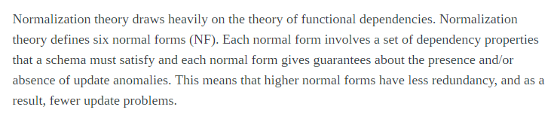

Slide 29
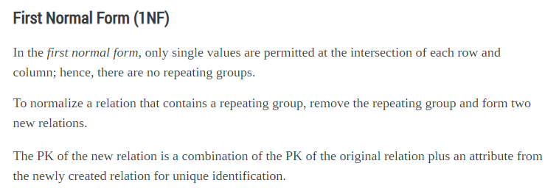

Slide 30
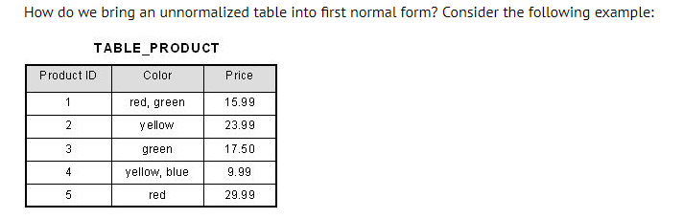
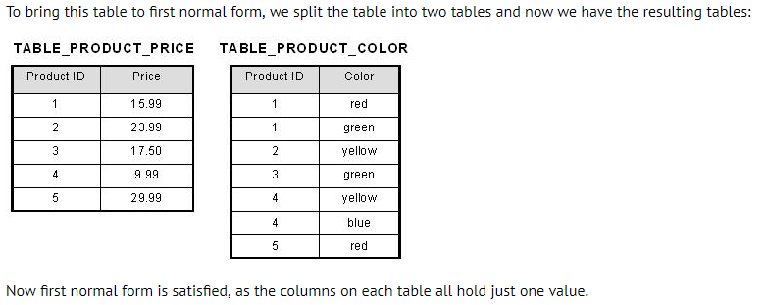

Slide 31
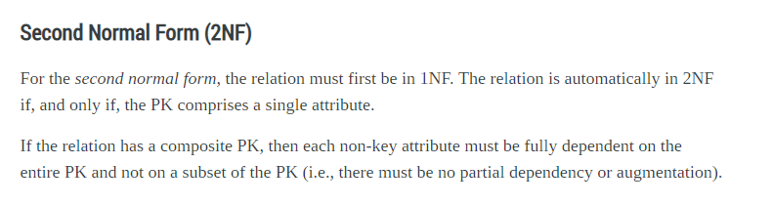

Slide 32
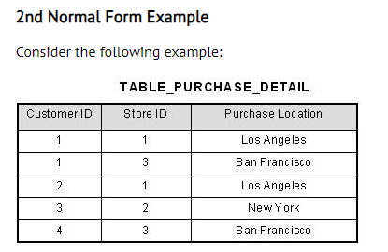
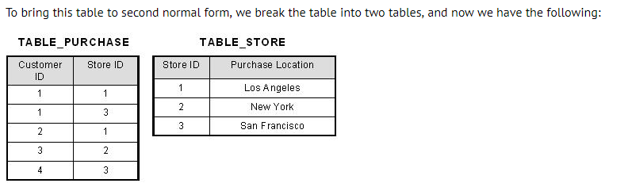
This table has a composite primary key [Customer ID, Store ID]. The non-key attribute is [Purchase Location]. In this case, [Purchase Location] only depends on [Store ID], which is only part of the primary key. Therefore, this table does not satisfy second normal form.
What we have done is to remove the partial functional dependency that we initially had. Now, in the table [TABLE_STORE], the column [Purchase Location] is fully dependent on the primary key of that table, which is [Store ID].

Slide 33
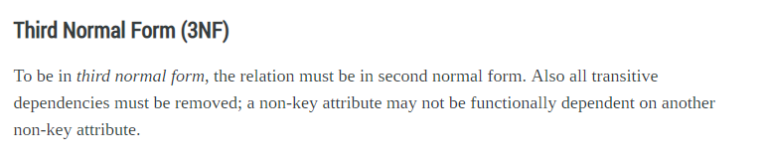
By transitive functional dependency, we mean we have the following relationships in the table: A is functionally dependent on B, and B is functionally dependent on C. In this case, C is transitively dependent on A via B.

Slide 34
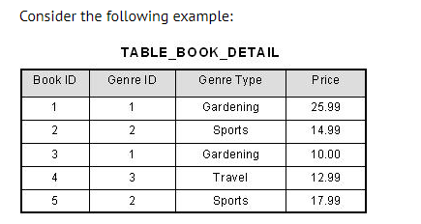
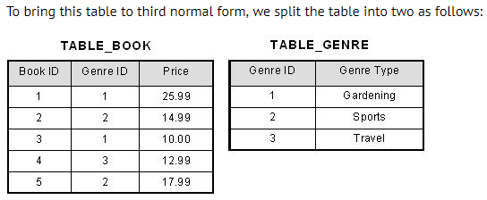
In the table able, [Book ID] determines [Genre ID], and [Genre ID] determines [Genre Type]. Therefore, [Book ID] determines [Genre Type] via [Genre ID] and we have transitive functional dependency, and this structure does not satisfy third normal form.
Now all non-key attributes are fully functional dependent only on the primary key. In [TABLE_BOOK], both [Genre ID] and [Price] are only dependent on [Book ID]. In [TABLE_GENRE], [Genre Type] is only dependent on [Genre ID].

Slide 35
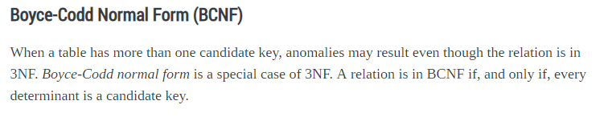
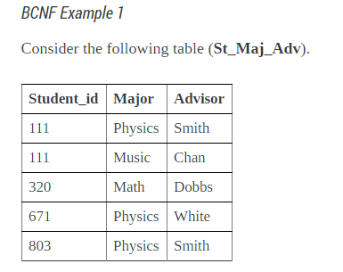
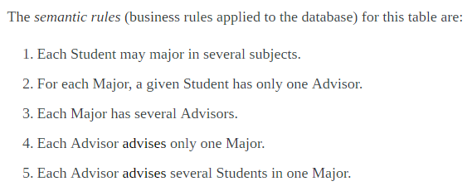

Slide 36
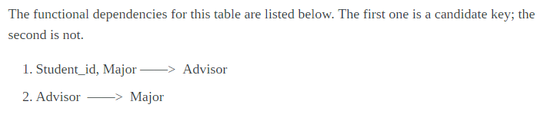
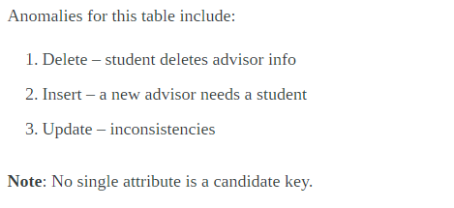

Slide 37
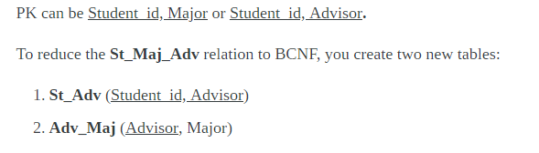
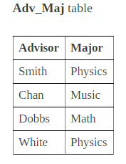
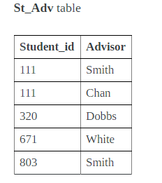

Slide 38
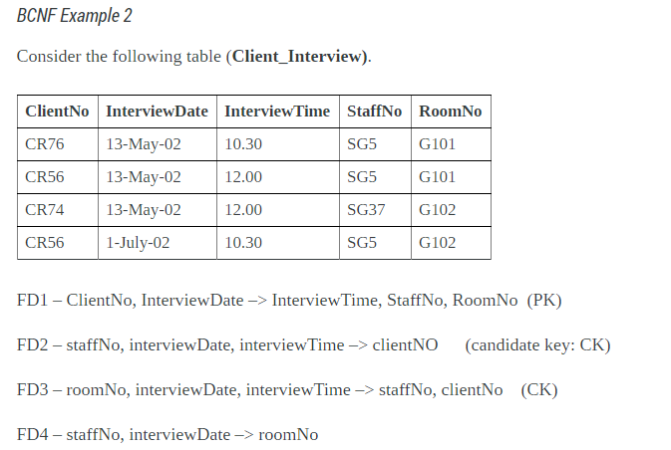

Slide 39

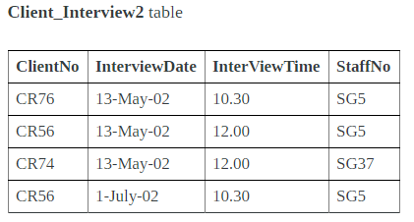
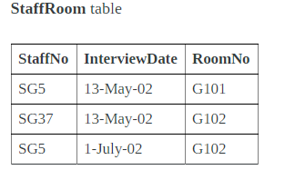

Slide 40
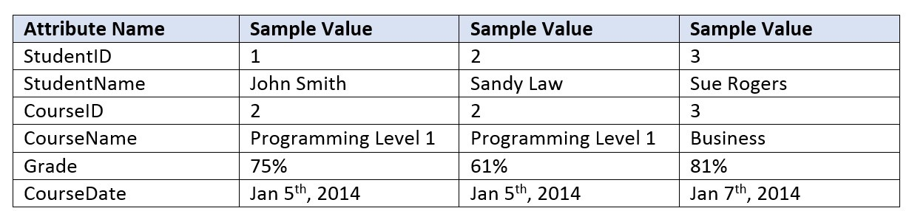
Draw the dependency diagram for this table.

Slide 41
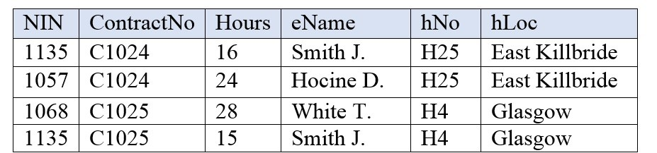
An agency called Instant Cover supplies part-time/temporary staff to hotels in Scotland. Figure 12.4 lists the time spent by agency staff working at various hotels. The national insurance number (NIN) is unique for every member of staff. Use Figure 12.4 to answer questions (a) and (b).
A. This table is susceptible to update anomalies. Provide examples of insertion, deletion and update anomalies.
B. Normalize this table to third normal form. State any assumptions.

Slide 42
4th Normal Form
It is in BCNF
There is no multi value dependency in relation

Slide 43
Emp-id | Language | skill
101 | English | Teaching
101 | Hindi | Conversation
101 | English | Conversation
101 | hindi | Teaching
202 | English | Singing
202 | Hindi | Teaching
Multivalued dependencies exist
Emp-id→ → language
Emp-id→ → skill
Anomalies
Delete—if id 101 discontinues teaching skill … then two rows to be delete
Update– if id 101 change its skill teaching to singing … then number of changes to be done.

Slide 44
This table could be divided in following two tables:
Emp-id | Language
101 | English
101 | Hindi
202 | English
202 | hindi
Emp-id | skills
101 | Teaching
101 | Conversation
202 | Singing
202 | Teaching

Slide 45
5th Normal Form
A relation R is in Fifth Normal Form (5NF) if and only if the following conditions are satisfied simultaneously:
1. R is already in 4NF.
2. It cannot be further non-loss decomposed.

Slide 46
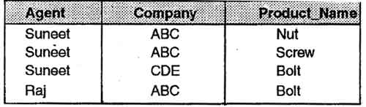
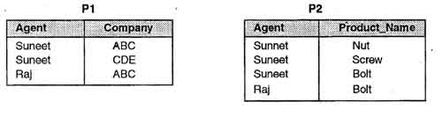
Consider Following data base:
Now this data base is decomposed into following two tables:

Slide 47
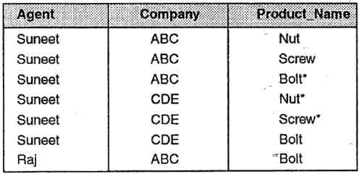
Now try to Re-Join these tables to re-create original table;;:::??????
Now try to find out anomalies it has now?

Slide 48
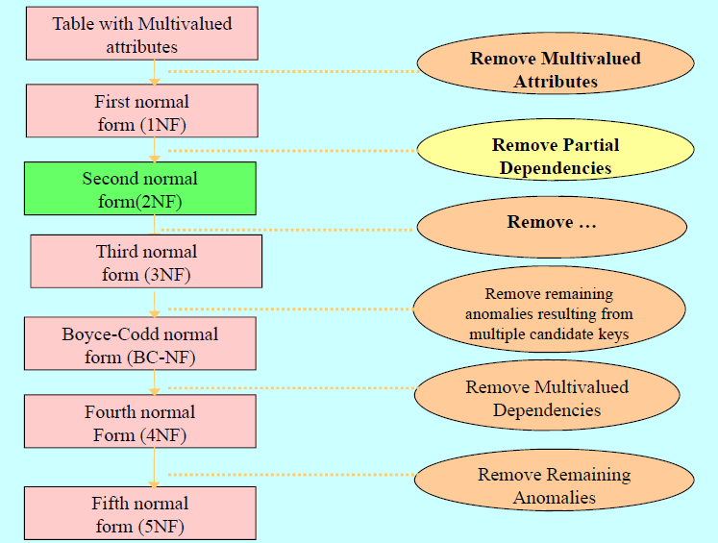
Over all picture of Normalization process:
transitive dependencies

Slide 49
E.F. Codd’s 12 Rules for RDBMS
Dr E.F.Codd, also known to the world as the ‘Father of Database Management Systems’ had propounded 12 rules which are in-fact 13 in number.
The rules are numbered from zero to twelve.
According to him, a DBMS is fully relational if it abides by all his twelve rules.
Till now, only few databases abide by all the eleven rules.

Slide 50
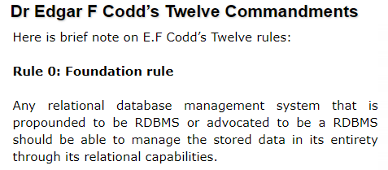
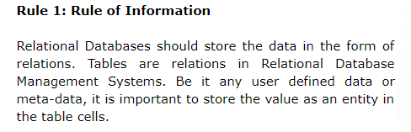
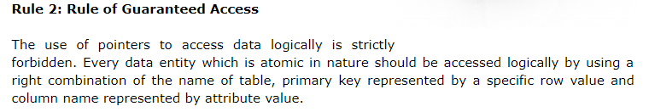
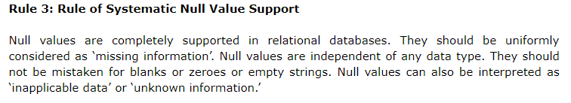

Slide 51
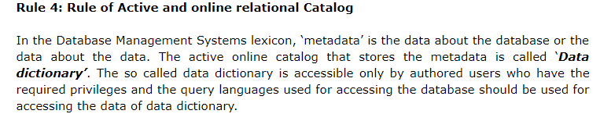
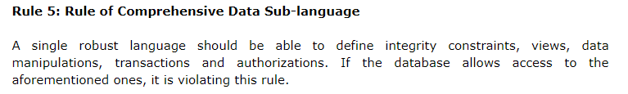
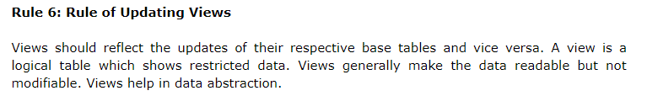


Slide 52

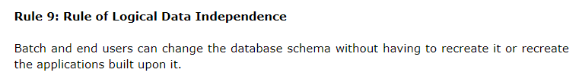


Slide 53



Slide 54



Slide 55

To solve this, we normalize tables. We have broken the above table into 2 tables, repeating columns we have moved into a separate table

Slide 56



Slide 57


Slide 58



Slide 59



Slide 60



